Slide 1
Time Division Duplexing (TDD)
By Mohd Azharuddin

Slide 2
What is Time Division Duplexing (TDD)?
full-duplex communication over a half-duplex communication
The transmitter and receiver both use the same frequency band
transmit and receive traffic at different times
TDD uses the same frequency band by assigning alternating time slots for transmit and receive operations.

Slide 3
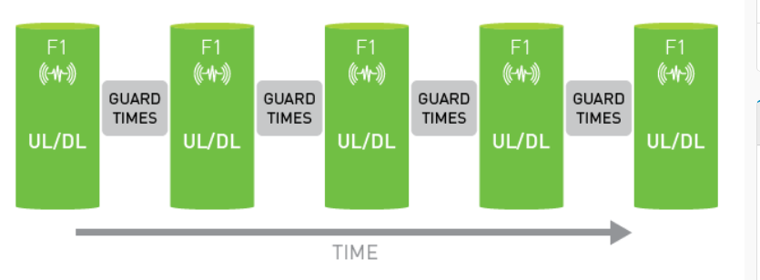

Slide 4
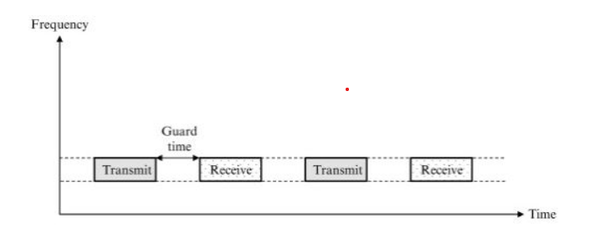
A guard time between transmit and receive streams is allocated

Slide 5
Advantages of TDD
Full utilization of bandwidth during the time slot results in better efficiency and throughput
Radios can be tuned for operation anywhere in a band and can be used at either end of the link. As a consequence, only a single spare is required to serve both ends of a link.

Slide 6
Disadvantages of TDD
As TDD operates based on allocated time slots, it requires stringent phase/time synchronization to avoid interference between UL (Uplink) and DL (Downlink) transmissions.
Multiple co-located radios can interfere with one another unless they are synchronized.

Slide 7
Thank You

